Slide 1



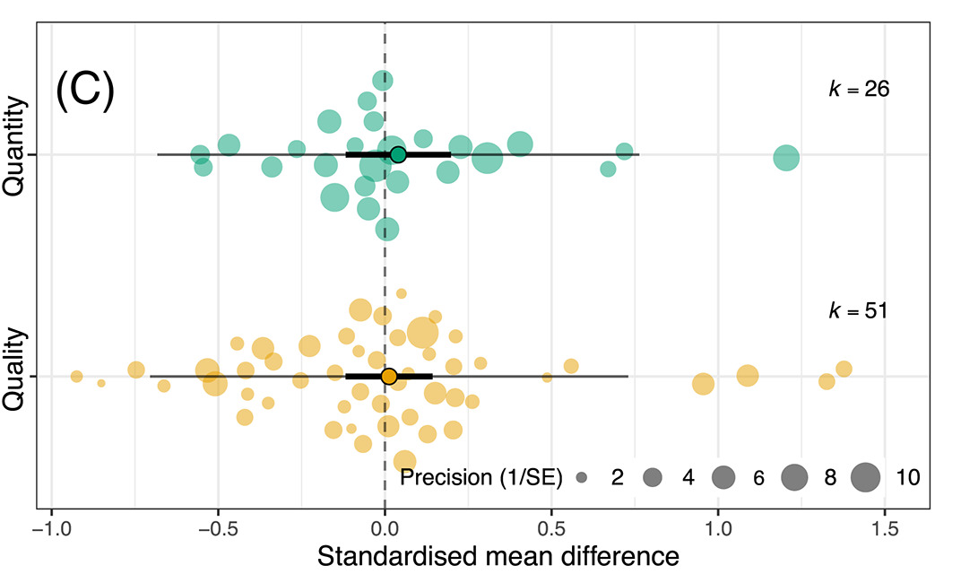
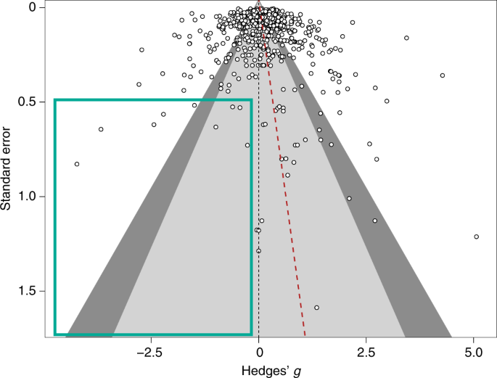




#SEBmeta
Meta-analysis in Comparative Physiology PART 1: A brief introduction to meta-analysis and effect sizes
Nakagawa et al. 2021
De Boer et al. 2021
Daniel Noble, Nicholas Wu, Essie Rodgers, Patrice Pottier

Slide 2







Acknowledgements
Julia Koricheva
Wolfgang Viechtbauer
Shinichi Nakagawa
Marc Lajeunesse
Malgorzata Lagisz
Rose O’Dea
Alistair Senior

Slide 3
What you want to get out of this?
Thanks for taking the survey!
Here’s what everyone wants

Slide 4


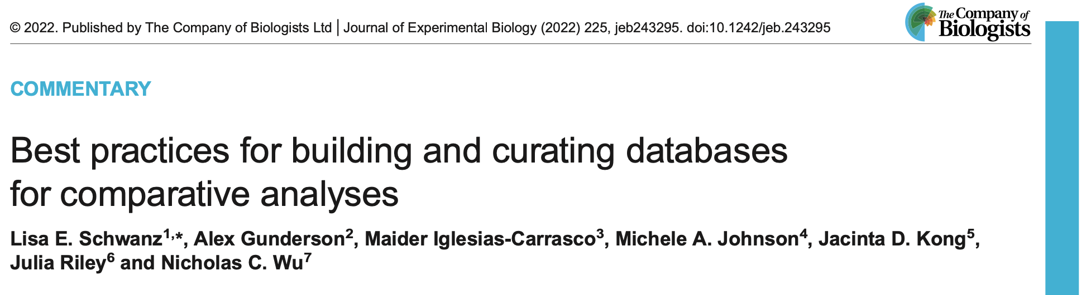
What we won’t have time to cover…sorry!
Question formulation
Systematic searching: refinement, inclusion criteria

Slide 5
Workshop Overview
Part 1: 9:00 – 10:30
What is meta-analysis and why should we use it?
Effect size and sampling variance: the key data for meta-analysis
What are effect sizes?
What types are out there and when to use?
Standardizing effect estimates – nuisance heterogeneity
Interpreting effect sizes and transformations
Assumptions, limitations, and common challenges
Part 2: 11:00 – 12:30
Meta-analytic modelling
Fixed and random effect meta-analyses
Multi-level meta-analytic models (MLMA): The main types in comparative physiology
Non-independence – phylogeny, study, species, shared controls
Robust variance estimation
Sensitivity analyses
Meta-regression and heterogeneity
Interpreting and reporting meta-analytic model output
Publication bias
Time-lag, reporting bias
Detecting and correcting
Part 3: 14:45 – 16:00
Help (advice) with your own meta-analysis! (if you need it)

Slide 6


We have a webpage!
https://daniel1noble.github.io/meta-workshop/

Slide 7



What we’ll use to code and analyze

Slide 8
https://wviechtb.github.io/metafor/articles/pkgdown/diagram.png

Slide 9
What is a meta-analysis?

Slide 10
What is a meta-analysis?
Statistical methods and techniques for aggregating, summarizing, and drawing inferences from collections of studies
Part of a Systematic Review
Collate empirical evidence that fits pre-specified eligibility criteria in order to answer a specific research question
Explicit, systematic methods are selected with a view to minimize bias
Provides more reliable findings from which conclusions can be drawn and decisions made

Slide 11
Why do we want to do meta-analysis?

Slide 12
Why do we want to do meta-analysis?
Meta-analysis increases power and precision to estimate effects
Individual studies are (often) underpowered (Jennions & Møller, 2003)
High sampling variability can exaggerate effects; don’t put too much faith in a single study.
Establishes generalities
Explores differences between studies and why they exist
Generates new hypotheses
Helps settle controversies from conflicting empirical studies
Can identify potential publication biases
Identify knowledge gaps to provide guidance for future empirical studies

Slide 13
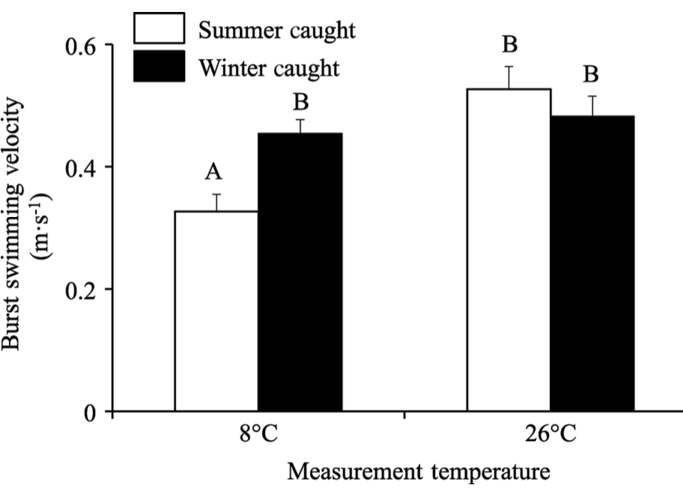
But what does this all mean?
Assume we want to conduct an experiment measuring burst swimming speed at two temperatures using some fish species
We take a sample of 20 fish acclimated to summer temperatures and measure burst swim speed for 10 fish at 8ºC and another 10 fish at 26ºC.
What is the difference in burst swimming speed between winter acclimated fish at the two measurement temperatures?

Slide 14
Our first experiment…..in silico
# Speed at 8 C treatment trt_8C <- rnorm(10, 0.4, 0.5) # Speed at 26 C treatment trt_26C <- rnorm(10, 0.6, 0.2) # What's the difference, i.e., effect size, between treatments? mean(trt_26C - trt_8C)
## [1] 0.1188703
t.test(trt_26C, trt_8C)
## ## Welch Two Sample t-test ## ## data: trt_26C and trt_8C ## t = 0.82071, df = 11.497, p-value = 0.4285 ## alternative hypothesis: true difference in means is not equal to 0 ## 95 percent confidence interval: ## -0.1982425 0.4359832 ## sample estimates: ## mean of x mean of y ## 0.5334862 0.4146159

Slide 15
Our second experiment….
# Speed at 8 C treatment trt_8C <- rnorm(10, 0.4, 0.5) # Speed at 26 C treatment trt_26C <- rnorm(10, 0.6, 0.2) # What's the difference, i.e., effect size, between treatments? mean(trt_26C - trt_8C)
## [1] 0.2729652
t.test(trt_26C, trt_8C)
## ## Welch Two Sample t-test ## ## data: trt_26C and trt_8C ## t = 1.6346, df = 16.942, p-value = 0.1206 ## alternative hypothesis: true difference in means is not equal to 0 ## 95 percent confidence interval: ## -0.0794437 0.6253740 ## sample estimates: ## mean of x mean of y ## 0.6630395 0.3900743

Slide 16
Our third experiment….woohoo!...wait, what?
# Speed at 8 C treatment trt_8C <- rnorm(10, 0.4, 0.5) # Speed at 26 C treatment trt_26C <- rnorm(10, 0.6, 0.2) # What's the difference, i.e., effect size, between treatments? mean(trt_26C - trt_8C)
## [1] 0.4113465
t.test(trt_26C, trt_8C)
## ## Welch Two Sample t-test ## ## data: trt_26C and trt_8C ## t = 2.525, df = 13.776, p-value = 0.0245 ## alternative hypothesis: true difference in means is not equal to 0 ## 95 percent confidence interval: ## 0.06140173 0.76129118 ## sample estimates: ## mean of x mean of y ## 0.5352081 0.1238616

Slide 17
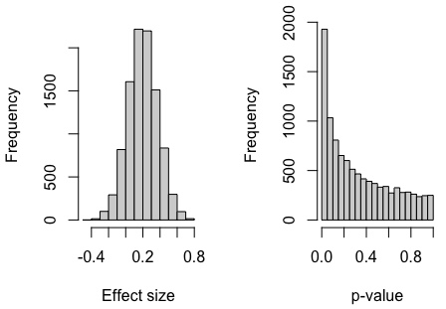
We got money to repeat experiments thousands of times…

Slide 18
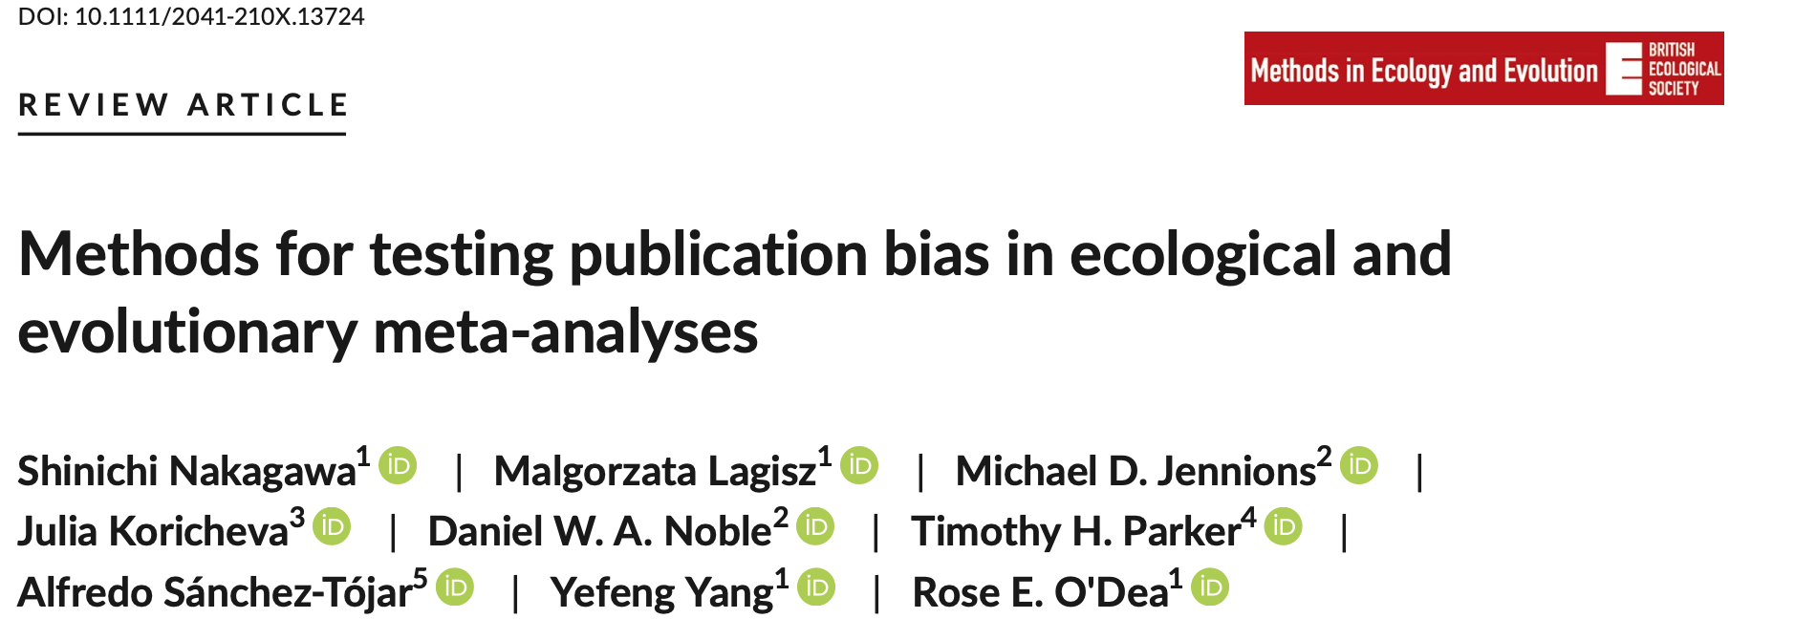
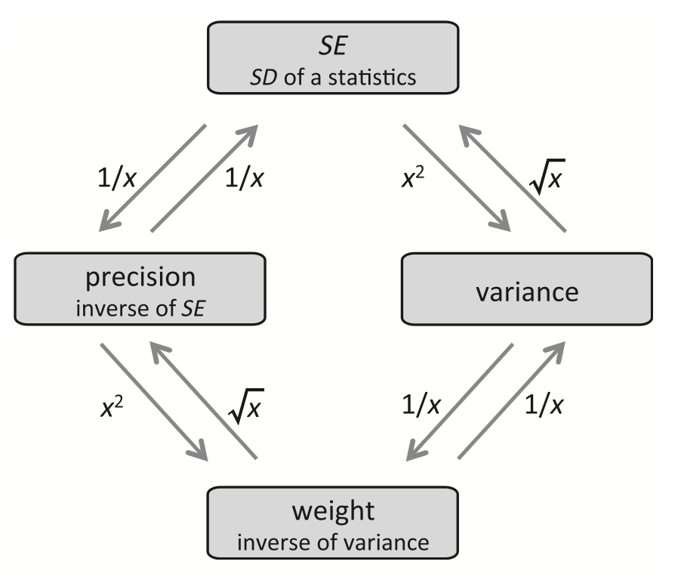
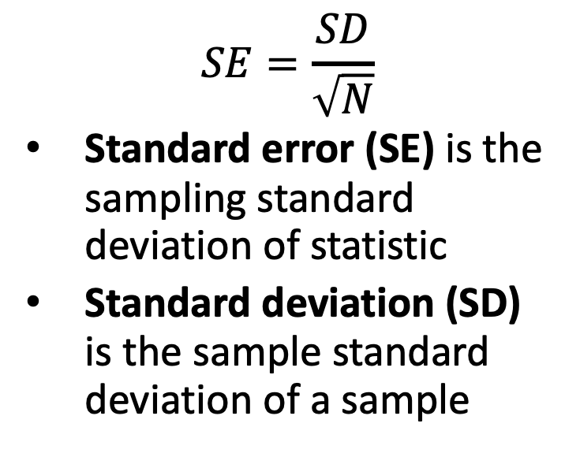
Standard error, standard deviation precision, weights
$$SE=\frac{SD}{\sqrt{N}}$$
Standard error (SE) is the sampling standard deviation of statistic
Standard deviation (SD) is the sample standard deviation of a sample

Slide 19
Meaning of standard error…
means <- c() for (i in 1:1e+06) { tmp <- rnorm(n = 18, mean = 10.8,
sd = 0.988) means <- c(tmp, mean(tmp)) } # The mean of the means mean(means)
## [1] 10.79997
# The standard deviation of the means or standard error sd(means)
## [1] 0.2327267

Slide 20
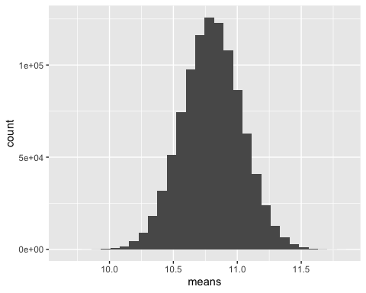

Meaning of standard error…
$$SE=\frac{SD}{\sqrt{N}}$$
# The standard error of a sample
se <- sd(tmp)/
sqrt(length(tmp))
## [1] 0.228051
# The standard deviation of the means or standard error sd(means)
## [1] 0.2327267

Slide 21
But what is an ‘effect size’?
A measure of the magnitude (and direction) of difference, association or central tendency that is comparable across studies
Core unit of analysis in meta-analysis
Have an associated sampling variance
Assumptions
Approximately normally distributed
Independent and identically distributed samples
But can be relaxed with use of different equations

Slide 22
“Effect size” value
e.g. 30% difference, a slope of 1.2, r = 0.2
“Effect size” statistic (or effect statistic)
e.g. d, r and odds ratio
The biological (practical/clinical) importance of an “effect-size” value
e.g. r = 0.5 is a ”strong” correlation
e.g. a 5% increase in death is not negligible

Slide 23
Different effect size statistics
Data Type
Continuous data
Binary / proportion data
Comparison between means
Odds Ratio (log transformed)
Standardised Mean Difference
Regression Slopes
Pearson’s Correlation
(Z transformed)
Risk ratio
Response ratio
Rate differences

Slide 24
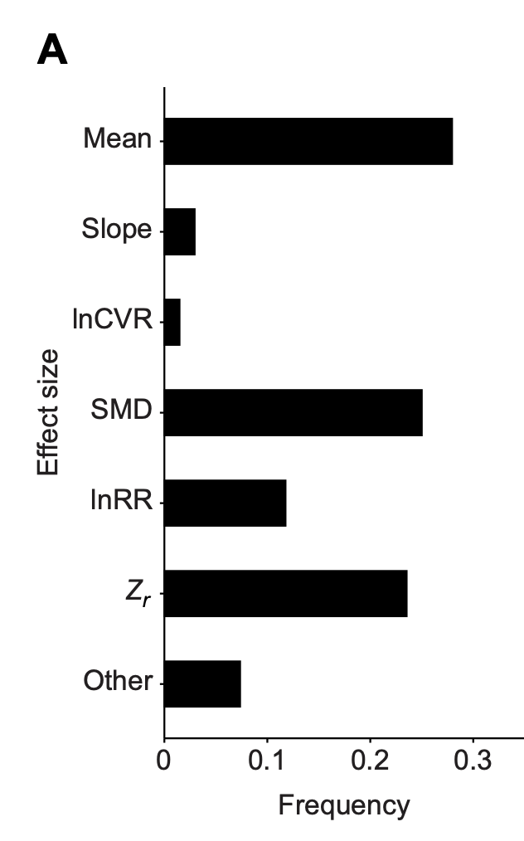
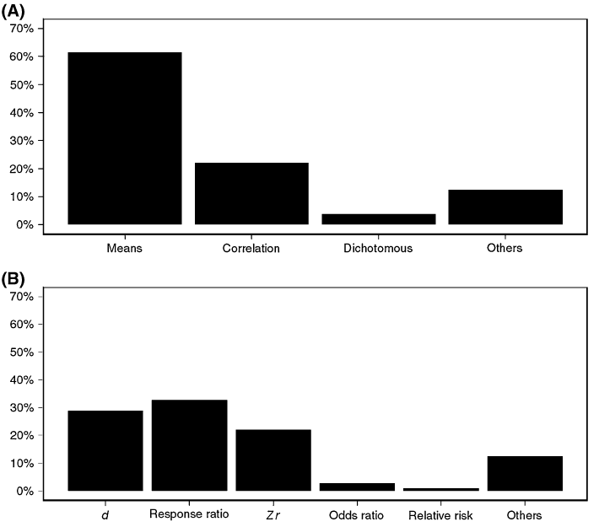
Different effect size statistics
Comparative Physiology
Ecology and Evolution
Noble et al. (2022); 63 meta-analyses
Nakagawa & Santos (2012); 100 meta-analyses

Slide 25
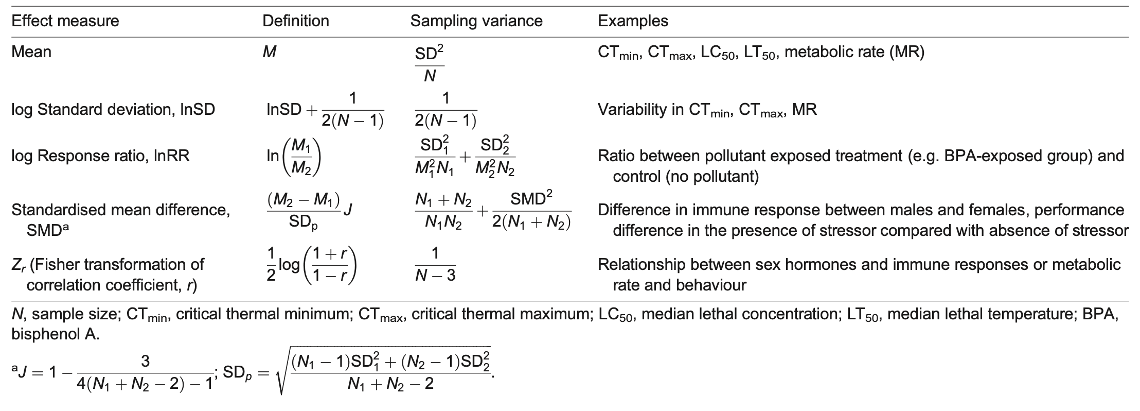
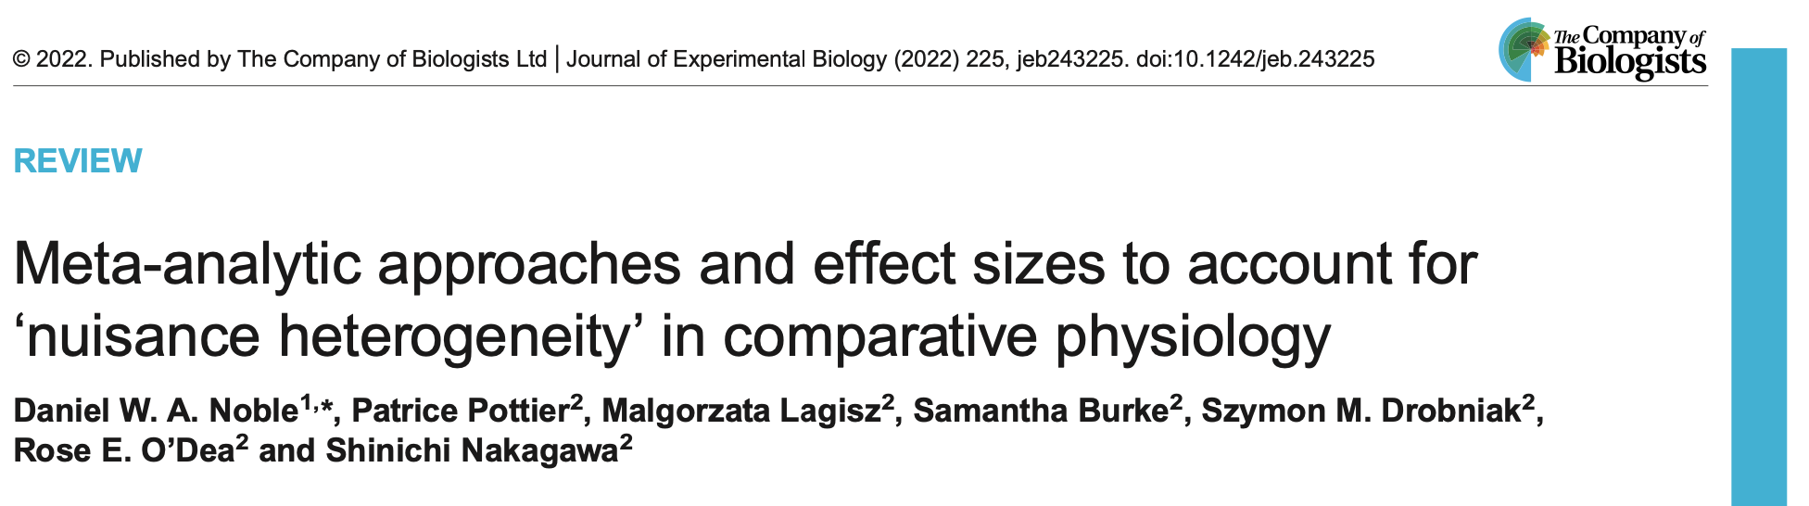
Calculation of some common effect statistics…

Slide 26
What to extract to get ES
Descriptive statistics: Means (medians) and SD (SE or confidence intervals) and r
Inferential statistics (t, z, Chi-square, F)
Also get N or degrees of freedom (df)

Slide 27
What to extract to get ES
Non-parametric statistics (Mann-Whitney, Kruskal-Wallis)
Handbook of Statistical Distributions with Applications (Krishnamoorthy 2006)
Getting means and SD from medians and ranges?
Hozo et al. (2005, 5:13; BMC Med. Res. Method.)
Mixed models.... (difficult)

Slide 28




What to extract to get ES
Many papers fail to report the relevant information
Getting descriptive stats from figures
The R packages, metaDigitise (Pick et al. 2019, Methods Ecol Evol) and ShinyDigitise (+ Ed Ivimey-Cook)
juicr (by Marc Lajeunesse)
Emailing the authors – usually very helpful
Success rate of 60-80% (difficult with old papers….)
A useful conversion resource for inferential statistics, Effect Size Calculator (web-based) http://www.campbellcollaboration.org/resources/effect_size_input.php

Slide 29

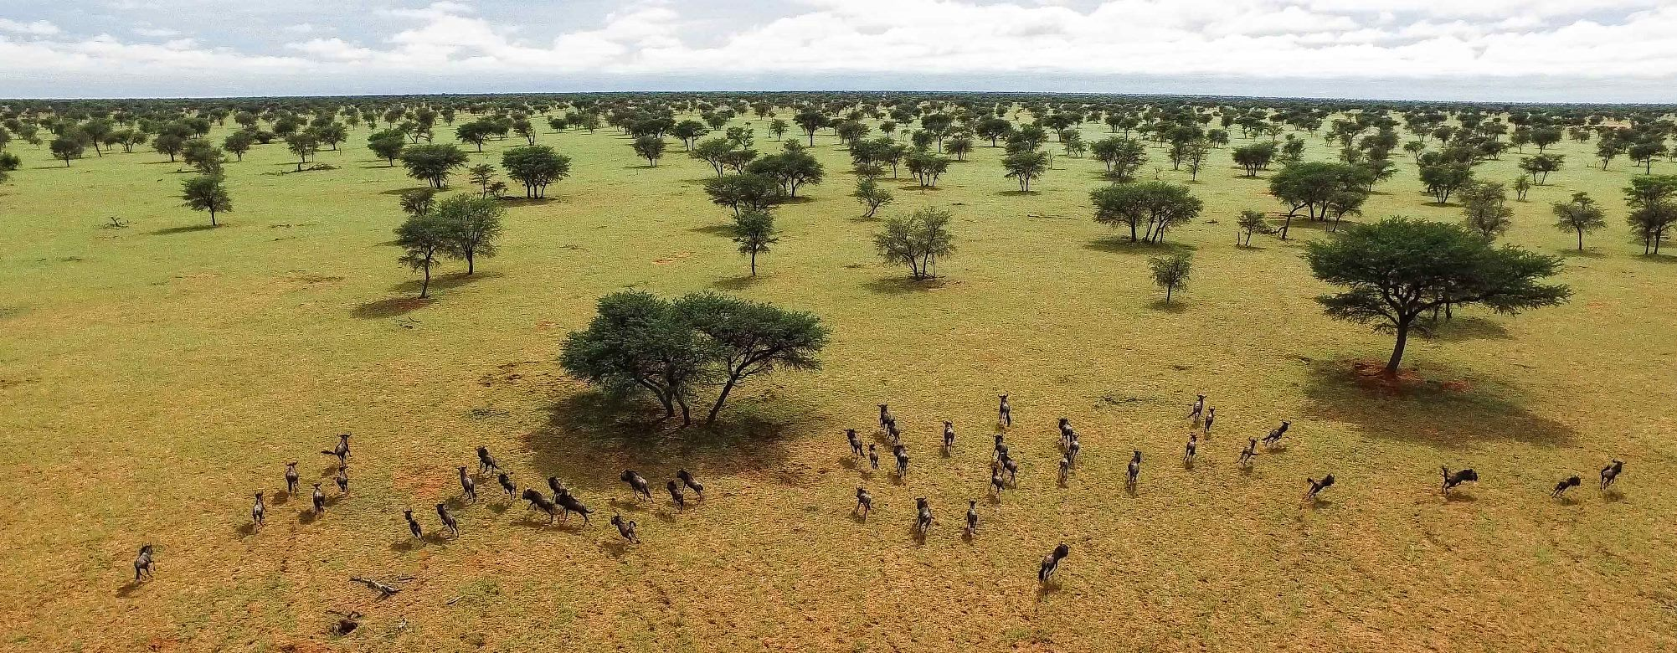

Slide 30
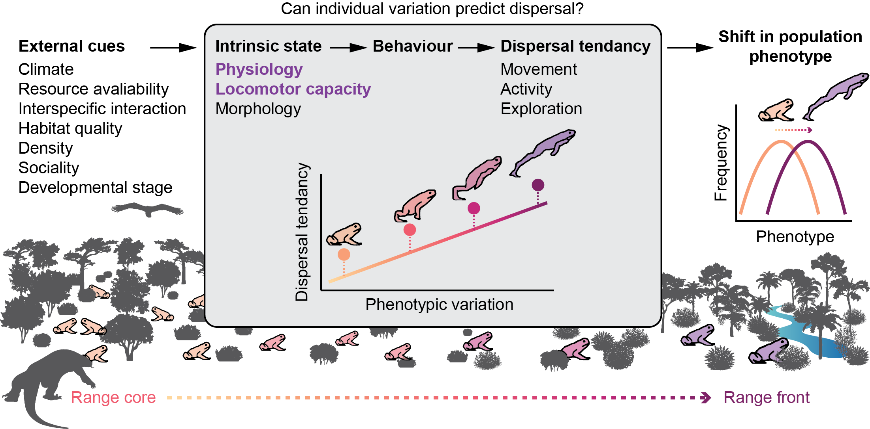
Climate change is shifting species distribution
Not all individuals disperse
e.g. individuals with higher metabolic rate more likely to disperse

Slide 31
Problem
Dispersal not a common trait measured.
Activity and exploration more common.
Individual variation in dispersal tenancy and population differences are not comparable.
Requires strict definition of activity, exploration, dispersal,
Difference effect sizes required.
Notes:
Most studies measuring ‘activity’ and ‘exploration’ were laboratory-based (85%), while dispersal was measured primarily in the field (90%).
‘Activity’ was defined as a movement in a familiar environment measured as distance moved or the number of movements per unit of time.
‘Exploration’ was defined as movement in an unfamiliar environment reported as distance moved per unit time, latency to enter an unfamiliar environment, a number of times re-entering an arena, a number of unique zones visited, or principal components related to these measured movement parameters.
‘Dispersal’ was defined as a muscle-powered, non-returning movement away from breeding home ranges that are completed within one generation.
Excluded migration, which is a returning movement between feeding and breeding home ranges, and passive dispersal through dispersal vectors such as water- and wind-currents, or transport by other organisms.

Slide 32
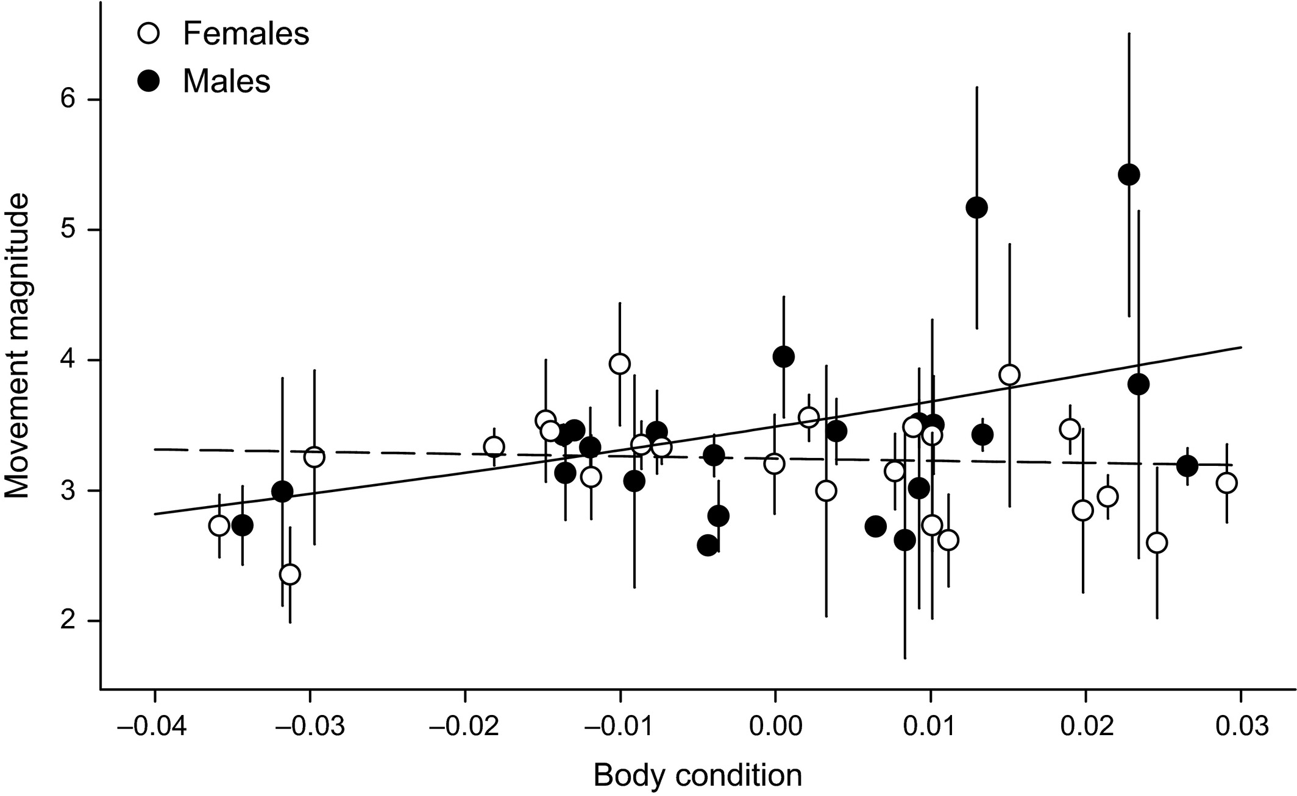
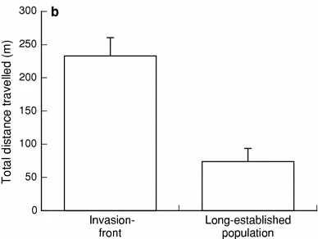
Data collection
Correlation-based (Zr)
Contrast-based (lnRR)
Physiological trait
Physiological trait
e.g., metabolism, cardiovascular, locomotor capacity
e.g., metabolism, cardiovascular, locomotor capacity
Moderators
Activity, exploration, dispersal
taxonomic group, thermoregulation strategy, sex, age, distance between core and edge pop
Moderators
taxonomic group, thermoregulation strategy, sex, age, origin
Notes:
taxonomic groups (amphibians, reptiles, invertebrates, mammals, birds),
thermoregulation strategy (ectotherm or endotherm),
sex (male, female, mixed),
age (juvenile, adult),
origin (wild-caught, captive-raised; the “origin” moderator is relevant for the ‘individual movement’ analysis only, and refers to common laboratory animals such as zebrafish).

Slide 33

Let’s try calculating some effects statistics…
Fisher’s Z transformed r: Zr
Why don’t we use, r, instead?

Slide 34
Let’s try calculating some effects statistics…
https://daniel1noble.github.io/meta-workshop/effect-size
# remove irrelevant columns for this tutorial and select first 10 effect sizes to illustrate escalc function
zr_data <- read.csv("https://raw.githubusercontent.com/daniel1noble/meta-workshop/gh-pages/data/ind_disp_raw_data.csv") %>% dplyr::select(study_ID, taxa, species, trait, response, response_unit, disp_trait, disp_unit, corr_coeff, sample_size) %>% dplyr::top_n(10)

Slide 35
Let’s try calculating some effects statistics…
# Calculate Fisher's r-to-z transformed correlation coefficient (ZCOR) as Zr = effect size and v_Zr = sampling variances, where ri = raw correlation coefficients, and ni = sample size. zr_data <- metafor::escalc(measure = "ZCOR", ri = corr_coeff, ni = sample_size, data = zr_data, var.names=c("Zr","v_Zr")) zr_data
## ## study_ID taxa species trait response ## 1 5 Mammalia Tamias_striatus Metabolism Resting MR ## 2 13 Aves Parus_major Metabolism Basal MR ## 3 13 Aves Parus_major Metabolism Basal MR ## 4 45 Mammalia Syncerus_caffer Condition Body condition ## 5 45 Mammalia Syncerus_caffer Condition Body condition ## 6 55 Aves Phoenicopterus_ruber Condition Body condition ## response_unit disp_trait disp_unit corr_coeff sample_size Zr v_Zr ## 1 residual mW Exploration residual -0.14300000 296 -0.1440 0.0034 ## 2 mass-corrected W Exploration 0.05547002 345 0.0555 0.0029 ## 3 mass-corrected W Exploration -0.13969969 335 -0.1406 0.0030 ## 4 index Dispersal % -0.40000000 415 -0.4236 0.0024 ## 5 index Dispersal % -0.53000000 508 -0.5901 0.0020 ## 6 Dispersal 0.87300000 462 1.3456 0.0022

Slide 36
Back transformation from Zr to r
# We can easily convert back to r as follows zr_data$r <- tanh(zr_data$Zr) zr_data %>% select(corr_coeff, r)
## ## corr_coeff r ## 1 -0.14300000 -0.14300000 ## 2 0.05547002 0.05547002 ## 3 -0.13969969 -0.13969969 ## 4 -0.40000000 -0.40000000 ## 5 -0.53000000 -0.53000000 ## 6 0.87300000 0.87300000 ## 7 0.06500000 0.06500000 ## 8 0.01500000 0.01500000 ## 9 0.17000000 0.17000000 ## 10 -0.13000000 -0.13000000

Slide 37
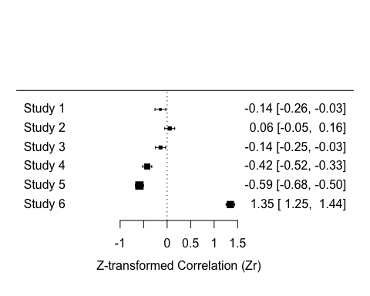
Forest plot of the effects
## response_unit disp_trait disp_unit corr_coeff sample_size Zr v_Zr ## 1 residual mW Exploration residual -0.14300000 296 -0.1440 0.0034 ## 2 mass-corrected W Exploration 0.05547002 345 0.0555 0.0029 ## 3 mass-corrected W Exploration -0.13969969 335 -0.1406 0.0030 ## 4 index Dispersal % -0.40000000 415 -0.4236 0.0024 ## 5 index Dispersal % -0.53000000 508 -0.5901 0.0020 ## 6 Dispersal 0.87300000 462 1.3456 0.0022
metafor::forest(x = zr_data$Zr[1:6], vi = zr_data$v_Zr[1:6], xlab = "Z-transformed Correlation (Zr)")

Slide 38
Forest plot of the effects
How do we know the confidence interval for each effect size??
## response_unit disp_trait disp_unit corr_coeff sample_size Zr v_Zr ## 1 residual mW Exploration residual -0.14300000 296 -0.1440 0.0034 ## 2 mass-corrected W Exploration 0.05547002 345 0.0555 0.0029 ## 3 mass-corrected W Exploration -0.13969969 335 -0.1406 0.0030 ## 4 index Dispersal % -0.40000000 415 -0.4236 0.0024 ## 5 index Dispersal % -0.53000000 508 -0.5901 0.0020 ## 6 Dispersal 0.87300000 462 1.3456 0.0022
metafor::forest(x = zr_data$Zr[1:6], vi = zr_data$v_Zr[1:6], xlab = "Z-transformed Correlation (Zr)")

Slide 39
Standardized mean difference, SMD: Hedges’ g
Let’s try calculating some effects statistics…contrast-based
g

Slide 40
Sampling (error) variance for Hedges’ d (SMD)
Let’s try calculating some effects statistics…contrast-based
The square-root of this is the “standard error (SE)” of Hedges’ d.

Slide 41

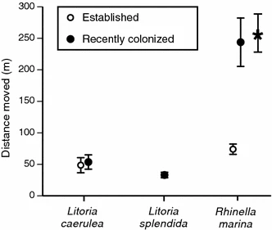
Let’s try calculating some effects statistics…contrast-based

Slide 42
Let’s try calculating some effects statistics …contrast-based
https://daniel1noble.github.io/meta-workshop/effect-size
# remove irrelevant columns for this tutorial & select first 10 effect sizes to illustrate escalc function
contrast_data <- read.csv("https://raw.githubusercontent.com/daniel1noble/meta-workshop/gh-pages/data/pop_disp_raw_data.csv") %>% dplyr::select(study_ID, taxa, species, trait, response, response_unit, mean_core, sd_core, n_core, mean_front, sd_front, n_front) %>% dplyr::top_n(10)

Slide 43
Let’s try calculating Hedges g…
# Calculate Hedges' g as g = effect size and v_g = sampling variances, where m1i = mean of edge population, n1i = sample size of edge population, sd1i = standard deviation of edge population, m2i = mean of core population, n2i = sample size of core population, sd2i = standard deviation of core population. contrast_data <- metafor::escalc(measure = "SMD", m1i = mean_front, n1i = n_front, sd1i = sd_front, m2i = mean_core, n2i = n_core, sd2i = sd_core, data = contrast_data, var.names=c("g","v_g")) contrast_data %>% select(study_ID, mean_core, sd_core, n_core, mean_front, sd_front, n_front, g, v_g)
## ## study_ID mean_core sd_core n_core mean_front sd_front n_front ## 1 9 0.8264591 0.41322957 98 0.9525292 0.58132296 161 ## 2 24 0.4333333 0.02804233 116 0.5116402 0.02698413 117 ## 3 34 2491.3240000 619.79470000 94 2528.9950000 603.98380000 96 ## 4 34 2491.3240000 619.79470000 94 2850.9130000 749.38730000 96 ## 5 37 1.3800000 0.18000000 2757 1.4400000 0.18000000 306 ## 6 37 1.3600000 0.17000000 2478 1.4100000 0.16000000 215 ## g v_g ## 1 0.2398 0.0165 ## 2 2.8366 0.0344 ## 3 0.0613 0.0211 ## 4 0.5203 0.0218 ## 5 0.3333 0.0036 ## 6 0.2954 0.0051

Slide 44
Let’s try calculating Hedges g…
# Calculate Hedges' g as g = effect size and v_g = sampling variances, where m1i = mean of edge population, n1i = sample size of edge population, sd1i = standard deviation of edge population, m2i = mean of core population, n2i = sample size of core population, sd2i = standard deviation of core population. contrast_data <- metafor::escalc(measure = "SMD", m1i = mean_front, n1i = n_front, sd1i = sd_front, m2i = mean_core, n2i = n_core, sd2i = sd_core, data = contrast_data, var.names=c("g","v_g")) contrast_data %>% select(study_ID, mean_core, sd_core, n_core, mean_front, sd_front, n_front, g, v_g)
## ## study_ID mean_core sd_core n_core mean_front sd_front n_front ## 1 9 0.8264591 0.41322957 98 0.9525292 0.58132296 161 ## 2 24 0.4333333 0.02804233 116 0.5116402 0.02698413 117 ## 3 34 2491.3240000 619.79470000 94 2528.9950000 603.98380000 96 ## 4 34 2491.3240000 619.79470000 94 2850.9130000 749.38730000 96 ## 5 37 1.3800000 0.18000000 2757 1.4400000 0.18000000 306 ## 6 37 1.3600000 0.17000000 2478 1.4100000 0.16000000 215 ## g v_g ## 1 0.2398 0.0165 ## 2 2.8366 0.0344 ## 3 0.0613 0.0211 ## 4 0.5203 0.0218 ## 5 0.3333 0.0036 ## 6 0.2954 0.0051
Interpret the first effect value for study 9. What does it tell us?

Slide 45
Let’s try calculating Hedges g…
# Calculate Hedges' g as g = effect size and v_g = sampling variances, where m1i = mean of edge population, n1i = sample size of edge population, sd1i = standard deviation of edge population, m2i = mean of core population, n2i = sample size of core population, sd2i = standard deviation of core population. contrast_data <- metafor::escalc(measure = "SMD", m1i = mean_front, n1i = n_front, sd1i = sd_front, m2i = mean_core, n2i = n_core, sd2i = sd_core, data = contrast_data, var.names=c("g","v_g")) contrast_data %>% select(study_ID, mean_core, sd_core, n_core, mean_front, sd_front, n_front, g, v_g)
## ## study_ID mean_core sd_core n_core mean_front sd_front n_front ## 1 9 0.8264591 0.41322957 98 0.9525292 0.58132296 161 ## 2 24 0.4333333 0.02804233 116 0.5116402 0.02698413 117 ## 3 34 2491.3240000 619.79470000 94 2528.9950000 603.98380000 96 ## 4 34 2491.3240000 619.79470000 94 2850.9130000 749.38730000 96 ## 5 37 1.3800000 0.18000000 2757 1.4400000 0.18000000 306 ## 6 37 1.3600000 0.17000000 2478 1.4100000 0.16000000 215 ## g v_g ## 1 0.2398 0.0165 ## 2 2.8366 0.0344 ## 3 0.0613 0.0211 ## 4 0.5203 0.0218 ## 5 0.3333 0.0036 ## 6 0.2954 0.0051
Interpret the first effect value for study 9. What does it tell us?
Marginal population mean is 0.24 SD units higher than core population mean (small effect)

Slide 46
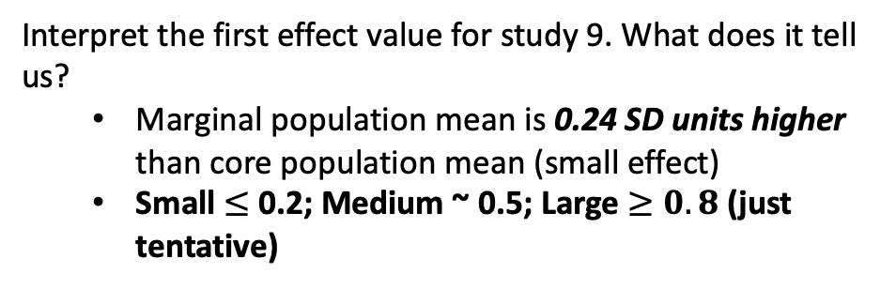
Let’s try calculating Hedges g…
# Calculate Hedges' g as g = effect size and v_g = sampling variances, where m1i = mean of edge population, n1i = sample size of edge population, sd1i = standard deviation of edge population, m2i = mean of core population, n2i = sample size of core population, sd2i = standard deviation of core population. contrast_data <- metafor::escalc(measure = "SMD", m1i = mean_front, n1i = n_front, sd1i = sd_front, m2i = mean_core, n2i = n_core, sd2i = sd_core, data = contrast_data, var.names=c("g","v_g")) contrast_data %>% select(study_ID, mean_core, sd_core, n_core, mean_front, sd_front, n_front, g, v_g)
## ## study_ID mean_core sd_core n_core mean_front sd_front n_front ## 1 9 0.8264591 0.41322957 98 0.9525292 0.58132296 161 ## 2 24 0.4333333 0.02804233 116 0.5116402 0.02698413 117 ## 3 34 2491.3240000 619.79470000 94 2528.9950000 603.98380000 96 ## 4 34 2491.3240000 619.79470000 94 2850.9130000 749.38730000 96 ## 5 37 1.3800000 0.18000000 2757 1.4400000 0.18000000 306 ## 6 37 1.3600000 0.17000000 2478 1.4100000 0.16000000 215 ## g v_g ## 1 0.2398 0.0165 ## 2 2.8366 0.0344 ## 3 0.0613 0.0211 ## 4 0.5203 0.0218 ## 5 0.3333 0.0036 ## 6 0.2954 0.0051
Interpret the first effect value for study 9. What does it tell us?
Marginal population mean is 0.24 SD units higher than core population mean (small effect)
Small $≤$ 0.2; Medium ~ 0.5; Large $≥0.8$ (just tentative)

Slide 47
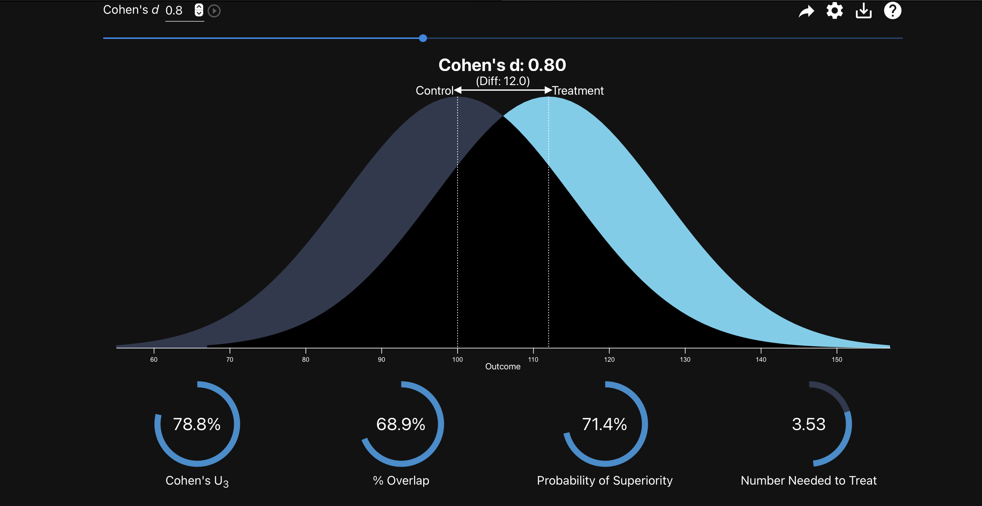
Understanding the meaning
of Hedges’ g…

Slide 48
Interpreting Hedges g…
Standardised difference so we can relate this back to a scale with a known SD
Assume we found that sprint speed at the marginal population compared to the core population had a Hedges g of g = 0.8 across studies
If we know SD of sprint speed is 1.2 then this implies that 0.8 x 1.2 = 0.96 m/s difference in speed on average between marginal and core populations

Slide 49
Interchangeability of effect sizes
Hedges’ d/g, Zr and log Odds ratios are all interchangeable.
Pick one, and make sure you convert others to the same statistic to meta-analyse together

Slide 50
Log Response Ratio (lnRR)
Another contrast-based effect statistic
Intuitive interpretation
Easy to calculate; effect not impacted by SD
But, only used with ratio scale data

Slide 51
Log Response Ratio (lnRR)
# Calculate log response ratio, lnRR = effect size and v_lnRR = sampling variances, where m1i = mean of edge population, n1i = sample size of edge population, sd1i = standard deviation of edge population, m2i = mean of core population, n2i = sample size of core population, sd2i = standard deviation of core population. contrast_data <- metafor::escalc(measure = "ROM", m1i = mean_front, n1i = n_front, sd1i = sd_front, m2i = mean_core, n2i = n_core, sd2i = sd_core, data = contrast_data, var.names=c("lnRR","v_lnRR")) contrast_data %>% select(study_ID, mean_core, sd_core, n_core, mean_front, sd_front, n_front, lnRR, v_lnRR)
## ## study_ID mean_core sd_core n_core mean_front sd_front n_front ## 1 9 0.8264591 0.41322957 98 0.9525292 0.58132296 161 ## 2 24 0.4333333 0.02804233 116 0.5116402 0.02698413 117 ## 3 34 2491.3240000 619.79470000 94 2528.9950000 603.98380000 96 ## 4 34 2491.3240000 619.79470000 94 2850.9130000 749.38730000 96 ## 5 37 1.3800000 0.18000000 2757 1.4400000 0.18000000 306 ## 6 37 1.3600000 0.17000000 2478 1.4100000 0.16000000 215 ## lnRR v_lnRR ## 1 0.1420 0.0049 ## 2 0.1661 0.0001 ## 3 0.0150 0.0013 ## 4 0.1348 0.0014 ## 5 0.0426 0.0001 ## 6 0.0361 0.0001
Interpret the first effect value for study 9. What does it tell us?

Slide 52
Log Response Ratio (lnRR)
# Calculate log response ratio, lnRR = effect size and v_lnRR = sampling variances, where m1i = mean of edge population, n1i = sample size of edge population, sd1i = standard deviation of edge population, m2i = mean of core population, n2i = sample size of core population, sd2i = standard deviation of core population. contrast_data <- metafor::escalc(measure = "ROM", m1i = mean_front, n1i = n_front, sd1i = sd_front, m2i = mean_core, n2i = n_core, sd2i = sd_core, data = contrast_data, var.names=c("lnRR","v_lnRR")) contrast_data %>% select(study_ID, mean_core, sd_core, n_core, mean_front, sd_front, n_front, lnRR, v_lnRR)
## ## study_ID mean_core sd_core n_core mean_front sd_front n_front ## 1 9 0.8264591 0.41322957 98 0.9525292 0.58132296 161 ## 2 24 0.4333333 0.02804233 116 0.5116402 0.02698413 117 ## 3 34 2491.3240000 619.79470000 94 2528.9950000 603.98380000 96 ## 4 34 2491.3240000 619.79470000 94 2850.9130000 749.38730000 96 ## 5 37 1.3800000 0.18000000 2757 1.4400000 0.18000000 306 ## 6 37 1.3600000 0.17000000 2478 1.4100000 0.16000000 215 ## lnRR v_lnRR ## 1 0.1420 0.0049 ## 2 0.1661 0.0001 ## 3 0.0150 0.0013 ## 4 0.1348 0.0014 ## 5 0.0426 0.0001 ## 6 0.0361 0.0001
Interpret the first effect value for study 9. What does it tell us?
There is an ~ 14% increase in trait mean at the marginal compared to core population
log(0.9525292 / 0.8264591) OR
log(0.9525292) – log(0.8264591)

Slide 53
Converting back to raw data to understand lnRR
### Let's back calculate effects to make sure we understand why they are interpreted as percentage differences # Make sure we understand how it's calculated with(contrast_data, log(mean_front[1] / mean_core[1]))
## [1] 0.1419703
# Alternatively.... with(contrast_data, log(mean_front[1]) - log(mean_core[1]))
## [1] 0.1419703
# Now lets back-transform. with(contrast_data, exp(log(mean_front[1]) - log(mean_core[1])))
## [1] 1.152542
# Interpretation: What this tells us is that the numerator (marginal (front) mean) is 1.15 times the denominator (Core mean), or, that the marginal (front) mean is 15% larger compared to the core mean. We can see that this is true as follows: with(contrast_data, exp(log(mean_front[1]) - log(mean_core[1])) * mean_core[1])
## [1] 0.9525292
# This value should now match the marginal mean value, which it does with(contrast_data, mean_front[1])
## [1] 0.9525292

Slide 54
Remember, all effect size statistics make assumptions…
Assumes normally distributed data
Independent samples
Equal variance in groups….
Data in physiology can vary a lot and these assumptions may not always been valid depending on units
Counts, latencies, proportions
Not always normal and can dramatically impact effect size values
Pay close attention to units and be critical about whether these will cause issues
Can result in outliers or influential points in analyses

Slide 55
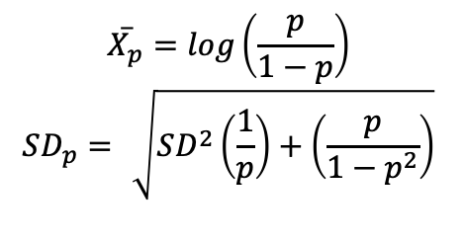
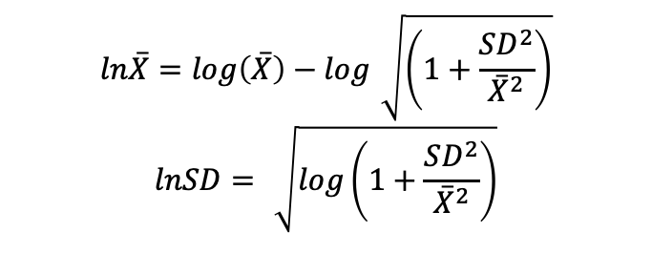
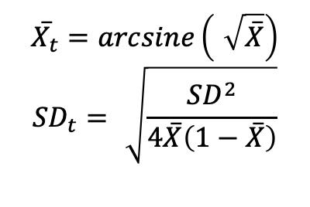
Transform raw means and sds….
Proportions
Latencies
$$\overset{‾}{X_{p}}=log\left(\frac{p}{1−p}\right)$$
$$SD_{p}=\sqrt{SD^{2}\left(\frac{1}{p}\right)+\left(\frac{p}{1−p^{2}}\right)}$$
$$\overset{‾}{X_{t}}=arcsine\left(\sqrt{\overset{‾}{X}}\right)$$
$$SD_{t}=\sqrt{\frac{SD^{2}}{4\overset{‾}{X}\left(1−\overset{‾}{X}\right)}}$$
$$ln\overset{‾}{X}=log\left(\overset{‾}{X}\right)−log\sqrt{\left(1+\frac{SD^{2}}{{\overset{‾}{X}}^{2}}\right)}$$
$$lnSD=\sqrt{log\left(1+\frac{SD^{2}}{{\overset{‾}{X}}^{2}}\right)}$$

Slide 56
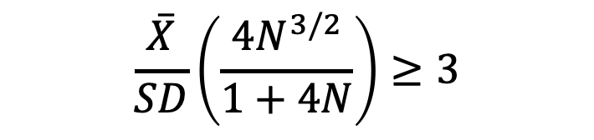
Transform raw means and sds….
Counts
If mean and variance are large then probably behaves normally
Model counts directly…Mengersen & Gurevitch (2013) chapter 7 (pg. 72).
If using lnRR check using Geary’s test
Do for control and treatment groups
Sensitivity analyses with and without effects that fail test (i.e., over 3) (Lajeunesse. 2015. Ecology, 96: pg 2061)
$$\frac{\overset{‾}{X}}{SD}\left(\frac{4N^{3/2}}{1+4N}\right)≥3$$

Slide 57
Criticisms for meta-analysis (limitations?)
Mixing of different kinds of studies (apples & oranges)
Too much emphasis on the overall effect size
Mixing good and bad studies (garbage in, garbage out)
Meta-analyses on the same topic disagree (happens a lot in medicine!)
Meta-analysis is useless because of the prevalence of publication bias

Slide 58
Mega-silliness
The very first ”meta-analysis”

Slide 59
Are standard effect sizes always appropriate?

Slide 60

Nuisance heterogeneity
Data and experiments in comparative physiology are highly heterogeneous
Temperatures, dosages etc.
Overall effects get complicated to interpret
Can be good and bad
Good:
Allows us to explore sources of heterogeneity in effects
Broader general conclusions
Bad:
Are we truly comparing the same thing?
Adds additional sources of heterogeneity that can complicate interpretations of findings.

Slide 61
Nuisance heterogeneity
Data and experiments in comparative physiology are highly heterogeneous
Temperatures, dosages etc.
Overall effects get complicated to interpret
Can be good and bad
Good:
Allows us to explore sources of heterogeneity in effects
Broader general conclusions
Bad:
Are we truly comparing the same thing?
Adds additional sources of heterogeneity that can complicate interpretations of findings.
‘Of course it [meta-analysis] mixes apples and oranges; in the study of fruit nothing else is sensible; comparing apples and oranges is the only endeavor worthy of true scientists; comparing apples to apples is trivial’ (p. 224, Glass, 2015)

Slide 62
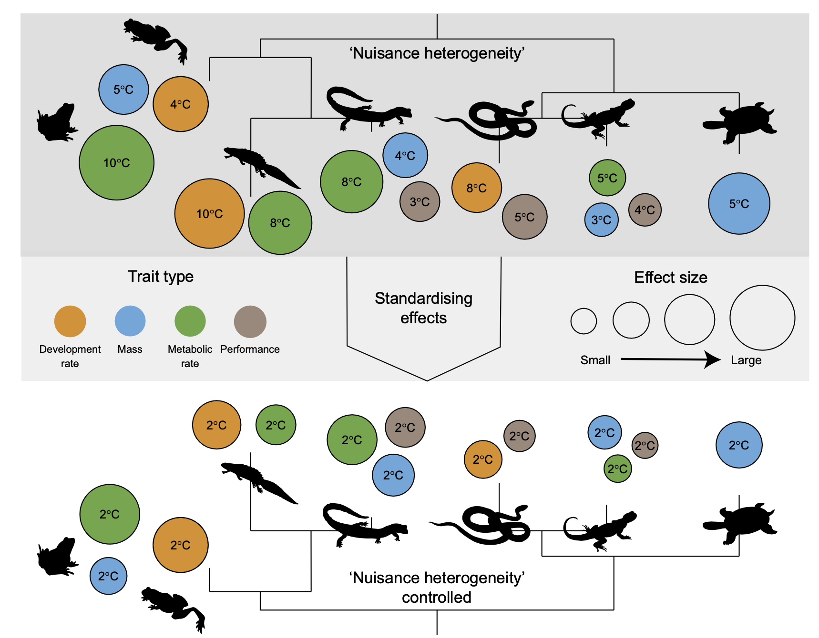
‘Nuisance heterogeneity’

Slide 63
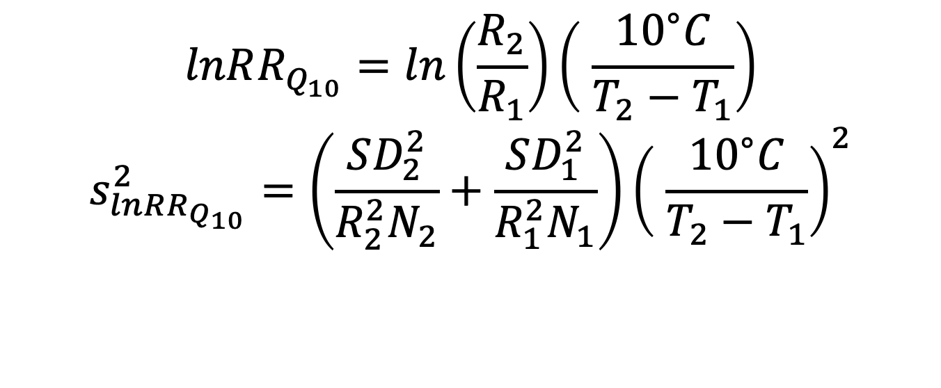
Some “new” effects sizes with sampling variance approximations…
$$lnRR_{Q_{10}}=ln\left(\frac{R_{2}}{R_{1}}\right)\left( \frac{{10}^{∘}C}{T_{2}−T_{1}}\right)$$
$$s_{lnRR_{Q_{10}}}^{2}=\left(\frac{SD_{2}^{2}}{R_{2}^{2}N_{2}}+\frac{SD_{1}^{2}}{R_{1}^{2}N_{1}}\right){\left( \frac{{10}^{∘}C}{T_{2}−T_{1}}\right)}^{2}$$

Slide 64
Some “new” effects sizes with sampling variance approximations…
$$lnRR_{Q_{10}}=ln\left(\frac{R_{2}}{R_{1}}\right)\left( \frac{{10}^{∘}C}{T_{2}−T_{1}}\right)$$
$$s_{lnRR_{Q_{10}}}^{2}=\left(\frac{SD_{2}^{2}}{R_{2}^{2}N_{2}}+\frac{SD_{1}^{2}}{R_{1}^{2}N_{1}}\right){\left( \frac{{10}^{∘}C}{T_{2}−T_{1}}\right)}^{2}$$

Slide 65
We need to turn our equations into functions….
https://daniel1noble.github.io/meta-workshop/nuis-het
#' @title lnRR_Q10 #' @description Calculates the log Q10 response ratio. Note that temperature 2 is placed in the numerator and temperature 1 is in the denominator #' @param t1 Lowest of the two treatment temperatures #' @param t2 Highest of the two treatment temperatures #' @param r1 Mean physiological rate for temperature 1 #' @param r2 Mean physiological rate for temperature 2 #' @param sd1 Standard deviation for physiological rates at temperature 1 #' @param sd2 Standard deviation for physiological rates at temperature 2 #' @param n1 Sample size at temperature 1 #' @param n2 Sample size at temperature 2 #' @param name Character string for column name #' @example #' lnRR_Q10(20, 30, 10, 5, 1, 1, 30, 30) #' lnRR_Q10(20, 30, 10, 5, 1, 1, 30, 30, name = "acclim") #' @export lnRR_Q10 <- function(t1, t2, r1, r2, sd1, sd2, n1, n2, name ="acute"){ lnRR_Q10 <- (10 / (t2 - t1)) * log(r2 / r1) V_lnRR_Q10 <- (10 / (t2 - t1))^2 * ((sd1^2 / (n1*r1^2)) + (sd2^2 / (n2*r2^2))) dat <- data.frame(lnRR_Q10, V_lnRR_Q10) colnames(dat) <- c(paste0("lnRR_Q10", name), paste0("V_lnRR_Q10", name)) return(dat) }

Slide 66
Let’s do some calculations…
q10_dat <- read.csv("https://osf.io/download/fb3ht/") # Calculate lnRRQ10 and it's associated sampling variance q10_dat <- cbind(q10_dat, with(q10_dat, lnRR_Q10(t1 = t1, t2 = t2, r1 = mean_t1, r2 = mean_t2, sd1 = sd_t1, sd2 = sd_t2, n1 = n_t1, n2 = n_t2, name = ""))) head(q10_dat)
## study_ID study_name year species order life_stage ## 1 119 119_Udyawer_etal_2016 2016 Hydrophis curtus serpentes unspecified ## 2 119 119_Udyawer_etal_2016 2016 Hydrophis curtus serpentes unspecified ## 3 119 119_Udyawer_etal_2016 2016 Hydrophis curtus serpentes unspecified ## 4 119 119_Udyawer_etal_2016 2016 Hydrophis elegans serpentes unspecified ## 5 119 119_Udyawer_etal_2016 2016 Hydrophis elegans serpentes unspecified ## 6 119 119_Udyawer_etal_2016 2016 Hydrophis elegans serpentes unspecified ## Q10 source lnRR_Q10 V_lnRR_Q10 ## 1 0.3257666 Fig1B -1.1215741 0.4596238 ## 2 0.1409586 Fig1B -1.9592889 0.3918671 ## 3 0.3143272 Fig1B -1.1573207 0.1956786 ## 4 0.4602349 Fig1B -0.7760182 0.4986339 ## 5 0.2384836 Fig1B -1.4334546 0.3569331 ## 6 0.4296305 Fig1B -0.8448297 0.1582664

Slide 67
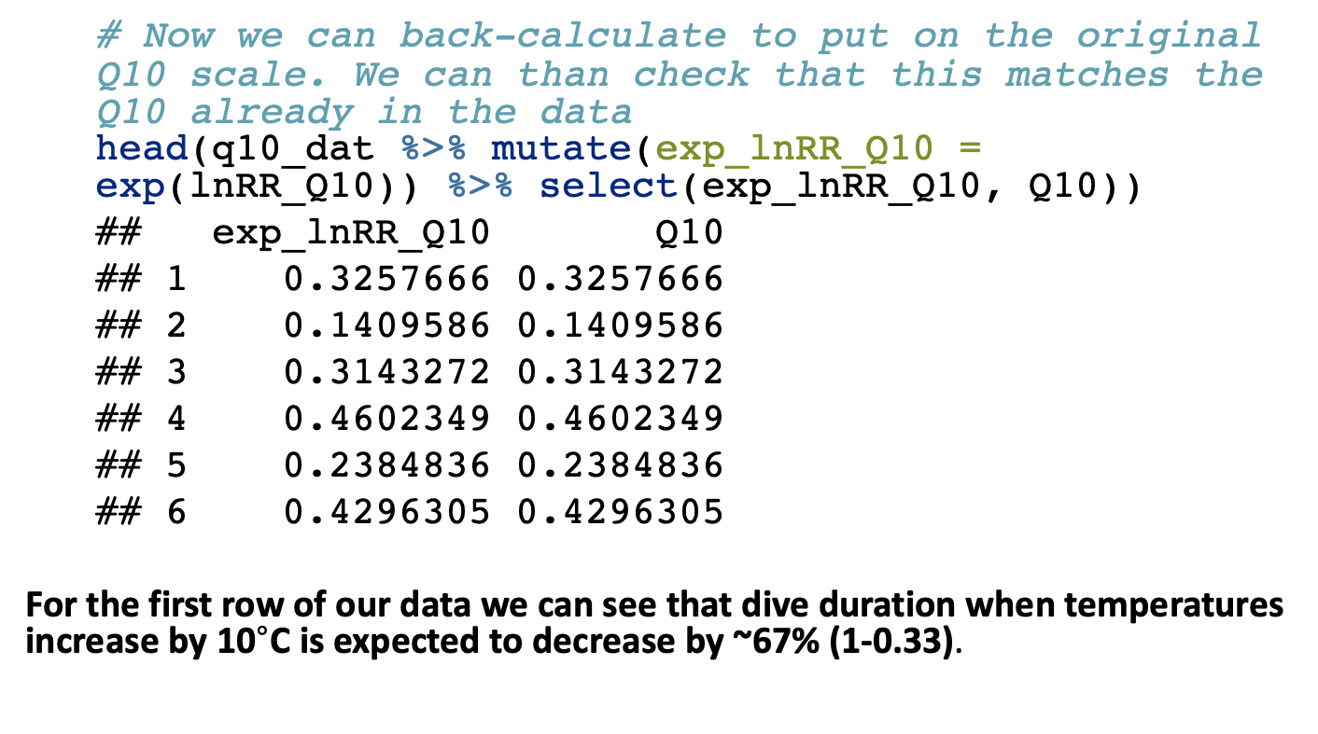
How to interpret?
# Now we can back-calculate to put on the original Q10 scale. We can than check that this matches the Q10 already in the data head(q10_dat %>% mutate(exp_lnRR_Q10 = exp(lnRR_Q10)) %>% select(exp_lnRR_Q10, Q10))
## exp_lnRR_Q10 Q10 ## 1 0.3257666 0.3257666 ## 2 0.1409586 0.1409586 ## 3 0.3143272 0.3143272 ## 4 0.4602349 0.4602349 ## 5 0.2384836 0.2384836 ## 6 0.4296305 0.4296305
For the first row of our data we can see that dive duration when temperatures increase by 10$​^{∘}$C is expected to decrease by ~67% (1-0.33).

Slide 68

How to interpret?
# Now we can back-calculate to put on the original Q10 scale. We can than check that this matches the Q10 already in the data head(q10_dat %>% mutate(exp_lnRR_Q10 = exp(lnRR_Q10)) %>% select(exp_lnRR_Q10, Q10))
## exp_lnRR_Q10 Q10 ## 1 0.3257666 0.3257666 ## 2 0.1409586 0.1409586 ## 3 0.3143272 0.3143272 ## 4 0.4602349 0.4602349 ## 5 0.2384836 0.2384836 ## 6 0.4296305 0.4296305
For the sixth row of our data we can see that dive duration when temperatures increase by 10$​^{∘}$C is expected to decrease by ~57% (1-0.429).

Slide 70
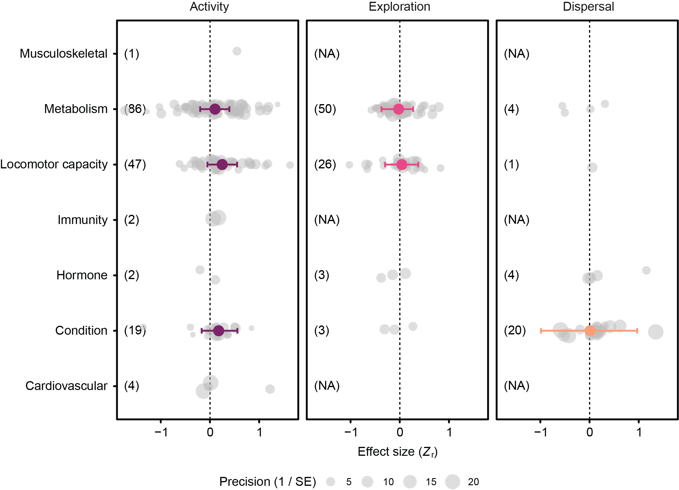
Results for correlation data

Slide 71
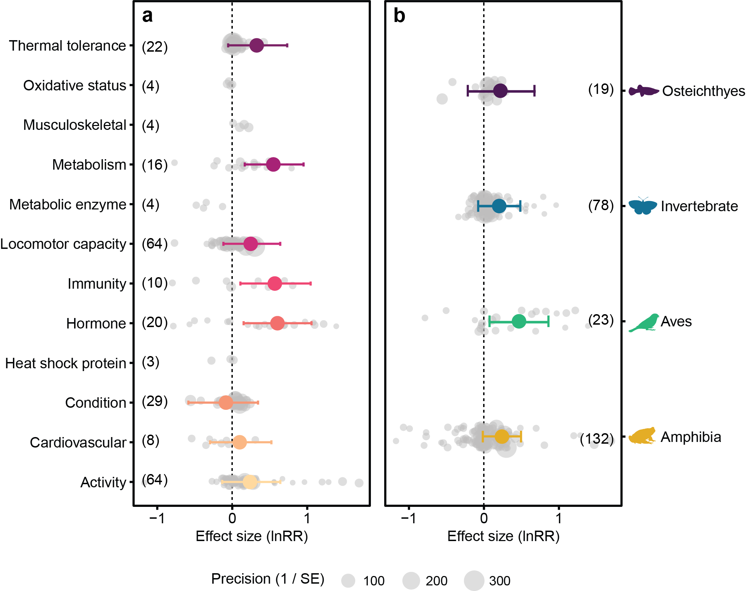
Results for contrast data

